Slide 1
Cost Concepts

Slide 2
Costs
Total fixed costs (TFC)
Average fixed costs (AFC)
Total variable costs (TVC)
Average variable cost (AVC)
Total cost (TC)
Average total cost (ATC)
Marginal cost (MC)

Slide 3
Fixed Costs
Result from owning a fixed input or resource.
Incurred even if the resource isn’t used.
Don’t change as the level of production changes (in the short run).
Exist only in the short run.
Not under the control of the manager in the short run.
The only way to avoid fixed costs is to sell the item.

Slide 4
Fixed Costs
Total fixed cost (TFC):
  All costs associated with the fixed input.
Average fixed cost per unit of output:
AFC = TFC
Output

Slide 5
Variable Costs
Can be increased or decreased by the manager.
Variable costs will increase as production increases.
Total Variable cost (TVC) is the summation of the individual variable costs.
Variable costs exist in the short-run and long-run:
  In fact, all costs are considered to be variable costs in the long run.

Slide 6
Variable Costs
Total variable cost (TVC):
  All costs associated with the variable input.
Average variable cost per unit of output:
AVC = TVC
Output

Slide 7
Total Cost
The sum of total fixed costs and total variable costs:
TC = TFC + TVC
In the short run TC will only increase as TVC increases.

Slide 8
Average Total Cost
Average total cost per unit of output:
AFC + AVC
ATC = TC
Output

Slide 9
Marginal Cost
The additional cost incurred from producing an additional unit of output:
MC = Δ TC
Δ Output
MC = Δ TVC
Δ Output

Slide 10
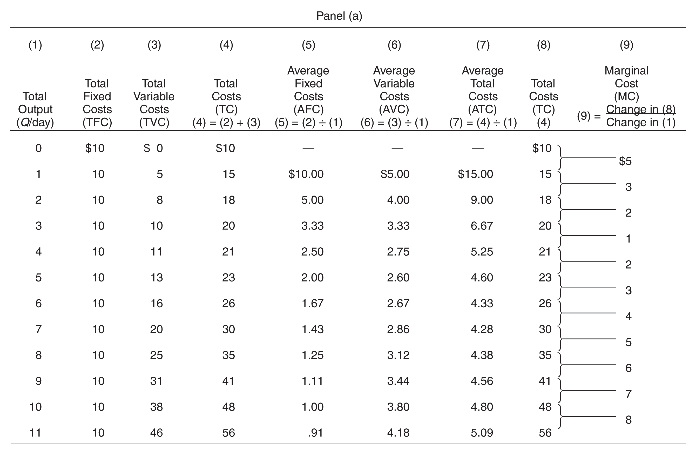
Cost of Production: An Example

Slide 11
Marginal Physical Product
Extra Output from each additional unit of resource

Slide 12
Marginal Revenue Product
Price x Extra Output
Change in Total Revenue Resulting from the use of each additional unit of resource

Slide 13
MRP as Resource Demand
(1)
Units of
Resource
(2)
Total Product
(Output)
(3)
Marginal
Product (MP)
(4)
Product
Price
(5)
Total Revenue,
(2) X (4)
(6)
Marginal Revenue
Product (MRP)
0
1
2
3
4
5
6
7
0
7
13
18
22
25
27
28
7
6
5
4
3
2
1
$2
2
2
2
2
2
2
2
$ 0
14
26
36
44
50
54
56
]
$14
12
10
8
6
4
2
]
]
]
]
]
]
]
]
]
]
]
]
]
$18
16
14
12
10
Resource Wage
(Wage Rate)
8
6
4
D=MRP
2
0
1
2
3
4
5
6
7
-2
Quantity of Resource Demanded
12-<number>

Slide 14
Marginal Resource Cost
Amount which each additional unit of resource adds to a firms total (resource) cost

Slide 15
MRP=MRC Rule
It is profitable for a firm to hire additional units of a resource up to that point at which that resources MRP=MRC

Slide 16
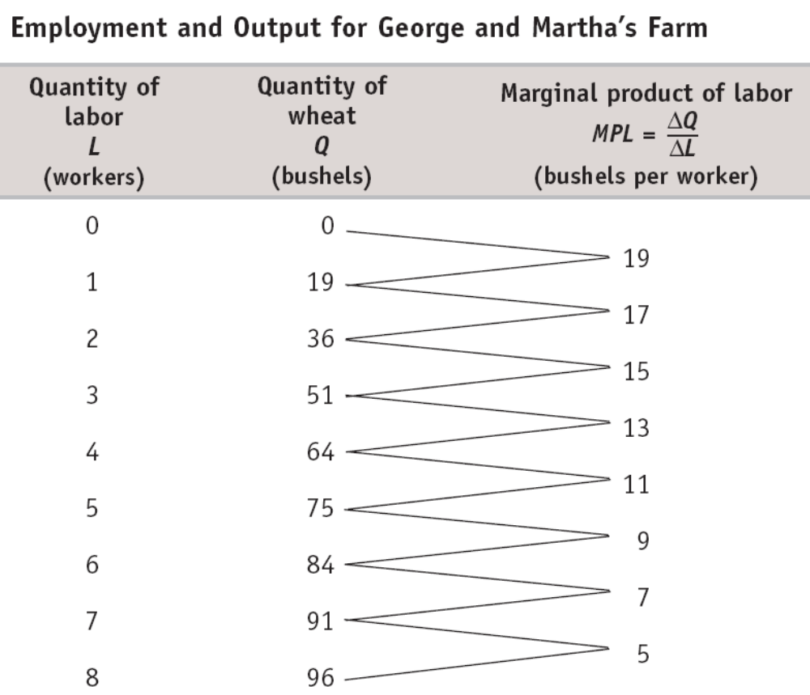

Slide 17
(a) Total Product
(b) Marginal Product of Labor
Quantity of wheat (bushels)
Marginal product of labor (bushels per worker)
100
TP
19
80
17
15
60
13
11
40
9
7
20
5
MPL
0
1
2
3
4
5
6
7
8
0
1
2
3
4
5
6
7
8
Quantity of labor (workers)
Quantity of labor (workers)
Notes:
Figure Caption: Figure 20-2: The Production Function for George and Martha’s Farm
Panel (a) shows how the quantity of output of wheat on George and Martha’s farm depends on the number of workers employed. Panel (b) shows how the marginal product of labor depends on the number of workers employed.

Slide 18
The Value of the Marginal Product Curve
Wage rate, VMPL
Optimal point
$400
300
A
Market wage rate
200
Value of the marginal product value curve
100
VMPL
0
1
2
3
4
5
6
7
8
Quantity of labor (workers)
Profit-maximizing number of workers
Notes:
Figure Caption: Figure 20-3: The Value of the Marginal Product Curve
This curve shows how the value of the marginal product of labor depends on the number of workers employed. It slopes downward because of diminishing returns to labor in production. To maximize profit, George and Martha choose the level of employment at which the value of the marginal product of labor is equal to the market wage rate. For example, at a wage rate of $200 the profit-maximizing level of employment is 5 workers, shown by point A. The value of the marginal product curve of a factor is the producer’s individual demand curve for that factor.

Slide 19
Project Estimation

Slide 20
Definition of estimating
‘To form an approximate notion of the amount, number, magnitude or position of anything, without actual enumeration or measurement.’
Oxford English Dictionary

Slide 21
What estimates are made in projects
Time estimates are used in scheduling work, and determining delivery dates.
Cost estimates are used for budgeting.
Cost and benefit estimates are used in cost/benefit analysis to determine the overall viability of a project.

Slide 22
Importance of accurate estimates
Inaccurate time estimates can result in inefficient use of resources and late delivery.
Inaccurate cost estimates can result in insufficient budget being allocated, or excess budget being set aside for the project when it could be used for other projects.
If the cost or benefits estimates are inaccurate this can lead to incorrect decisions about proceeding with the project being made.

Slide 23
Estimating methods
commonly used methods of estimating are:
Top down estimating
Bottom up estimating

Slide 24
Top-down method
Identify a previous project or section of a previous project that is similar to the current project.
Assess the extent to which the current project is similar to the previous project – the comparison factor .
Compute the estimate for the current project based on the actual durations, effort or costs from the previous project and the comparison factor.

Slide 25
Bottom-up method
The method uses the Work Breakdown Structure (WBS) developed during the planning stage of the project. Estimates are created for all tasks at the lowest level of the WBS and then these are accumulated to determine the estimates for the whole project.
One disadvantage of the bottom-up method is that it is much more time-consuming than other methods.

Slide 26
Verification of estimates
Estimates need to be reviewed to check they are realistic.
Using more than one method of estimating and/or two or more independent estimators to produce estimates, then comparing these provides a very effective verification of the estimates.
As tasks progress, regularly obtain updated estimates of effort, and time to complete the tasks from the resources performing the tasks. These are called “revised estimates” and should be used to keep project
schedules continually up to date.

